Slide 1

Library management system
Prepared by: 1. jahan patel 2. Anil kumar 3. Manan Goradiya 4. Ayush gupta

Slide 2

Agenda
INTRODUCTION
FEATURE AND TECHNOLOGY USED
BOOKS INFO AND RENTING FEATURE
DONATED BOOK FEATURE
FIREBASE FIRESTORE(FOR DATABASE)

Slide 3

INTRODUCTION
DESCRIPTION ABOUT THE PROJECT
Our project mainly focuses on basic operations in a library like adding new members, new books, updating new information, searching books, etc.
This application provides the basic functionality of books related information that are available in the library.
Using this web application anyone can donate book to library.
It also provides the ease of keeping a track of book issued, returned and added to library, so that the administration can do their work easily with less error.

Slide 4

Features and technology used
Overall features
Book Information provider (further explained).
Renting and status of book (further explained).
Donating book (further explained).
Overall features
HTML, CSS and JavaScript,
Node.js framework, and
Firebase firestore.

Slide 5
Info section
BOOK INFO PROVIDER
Book Info: In this section user can find the information of the book like name, last date issued, issued by and all the other necessary information, which a user must require to know about the current book status.
As we thought this might be helpful to each and every user in the aspect of their time. Any user using this can save his/her time by not just going into the library and started to find the book in spite of that the book he/she is finding is not available in the library.

Slide 6
Entry, issuing and renting
Entry Section:
In this section the user can enter the book details like book name, author name, category of book and other necessary details. So, that another user using the same tool can easily get the information about particular book easily.
Issuing Section:
Renting Section:
In this section user can issue a book alike pre-booking and enter the required details necessary for the administration for the records.
In this section a user can issue a book even if they are not the member for the library.

Slide 7
Donating feature
WE RISE BY LIFTING OTHERS.
This feature of the web app allows anyone to donate book to library, so that it can be reused by the students.
So, basically this feature is very useful in order to save books by not wasting or throwing into the garbage.
This feature provides user a GUI interface where he/she has to type few details, i.e., name of the book, category of book, book author name in order to donate the book.
After providing proper data these details will going to be stored in the library database.
Then, the donated books will be shown with different status normally like already having books to the students/faculties.

Slide 8
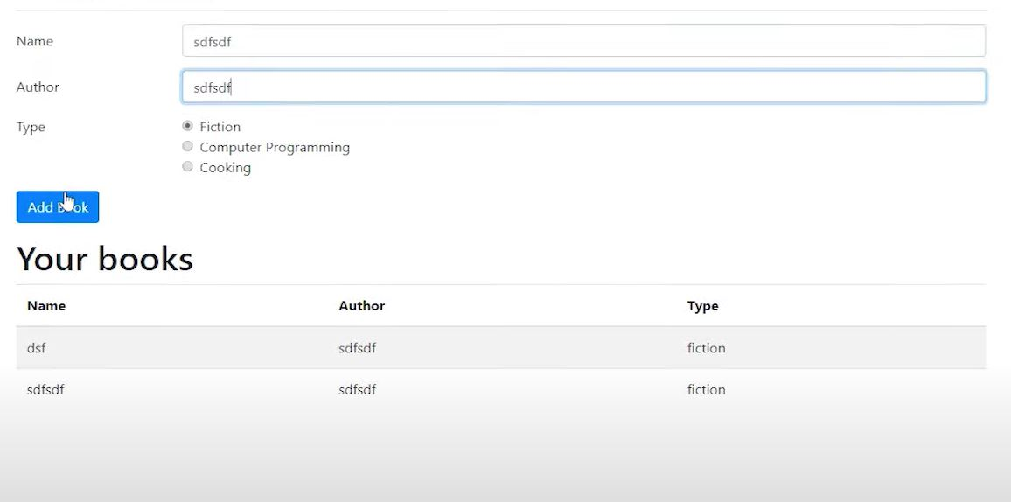
SAMPLE gui:

Slide 9

Firebase firestore
Here in these library management system we are using firestore for storing data related to books.
Admin’s account: The books present in the library will be added in library (admin) account.
User‘s account: The book borrowed by any particular student will be shown borrowed in the admin`s account and will be transferred in that particular user`s acc.
The book donated by any particular person will be transferred into admins account and details regarding the person will also be mentioned in the data.

Slide 10
THANK YOU
From Runtime Terror Team

